Slide 1
Introduction
Notes:
Hello, I am Jahee Kim, who will teach the Data Structures lecture this semester.
First of all, welcome to the Data Structures class.
Do you know what data structures are?
What can you really learn from this class?
How will the class be conducted?
Do you have a lot of homework?
I think today's lecture will answer these questions.
안녕하십니까, 저는 자료구조 및 알고리즘 강의를 맡은 김자희입니다.
먼저 자료구조 및 알고리즘 수업에 오신 걸 환영합니다.
여러분은 왜 이 과목을 선택하셨나요?
과연 이 수업을 통해서 무엇을 배울 수 있을까요?
수업은 어떤 식으로 진행이 될까요?
숙제는 많을까요?

Slide 2
What is Data Structures?

Slide 3









Where is data?
Data exists in various structures everywhere.
Notes:
Before discussing data structures, take a look around. People have rules about how to act and organize things or events in the real world. Just imagine. How do you pay when you go to a theater or a supermarket? The person who arrives first is served first. That is, you can see that it is processed in chronological order. How about a dictionary? All the words in the dictionary are sorted alphabetically.
What else? You may have written down your to-dos for the day on your smartphone or notebook. How are they organized? Some will be sorted by importance, some will be sorted alphabetically. But you won't write multiple to-dos on your to-do list.
By comparison, how about a shopping bag with items from the supermarket? There is no order inside a shopping bag, and there can be multiple items of the same item.
How about a genealogy? How are your family and ancestors organized?
There is a lot of information in the world, and we need to structure it in some way to process that information into a computer. This class covers the basics of how to organize and process various types of information in this world.
자료구조에 대해 설명하기 전에 주위를 둘러보세요. 사람들은 어떤 사물이나 사건에 대해 어떻게 행동하고 정리할 것인지에 대한 법칙을 갖고 있죠. 상상해 보 보세요. 여러분이 극장이나 마트에 가면 어떤 식으로 계산을 하나요? 먼저 온 사람부터 먼저 서비스를 받습니다. 즉, 시간순으로 처리된다는 걸 알 수 있죠. 사전은 어떤 가요? 사전에 있는 모든 단어들은 알파벳순으로 정렬되어 있죠.
또 어떤 게 있을까요? 여러분은 스마트폰이나 수첩에 오늘의 할 일을 적어뒀을 수 있겠죠. 그것들은 어떤 식으로 정리되어 있나요? 누군가는 중요도 순으로 누군가는 알파벳순으로 정렬되어 있을 겁니다. 하지만 to-do list에 한번 해야 할 일을 여러 번 적지는 않을 겁니다.
그에 비해서 슈퍼마켓에서 산 물건들을 담은 쇼핑백은 어떻죠? 쇼핑백 안에는 순서라는 것도 없고, 동일한 물건이 여러 개 들어있을 수 있습니다.
족보라는 건 어떻죠? 여러분의 가족과 조상들이 어떤 식으로 정리되어 있나요?
세상에는 수많은 정보가 있고, 우리는 그 정보를 컴퓨터로 처리하기 위해서 어떤 식으로든 구조화할 필요할 있습니다. 본 수업시간에는 이런 세상의 다양한 정보를 어떻게 조직화하여 컴퓨터로 처리할 것인가에 대한 기본적인 내용을 다룹니다.

Slide 4



Data Structure
Before DS
After DS
Notes:
책을 아무렇게나 섞어서 쌓아둘 수도 있지만 도서관처럼 종류별로 분류해 둔다면 쉽게 찾을 수 있을 겁니다. 이렇게 책과 같은 자료를 효율적으로 관리하는 방법이 자료구조에 해당합니다.

Slide 5
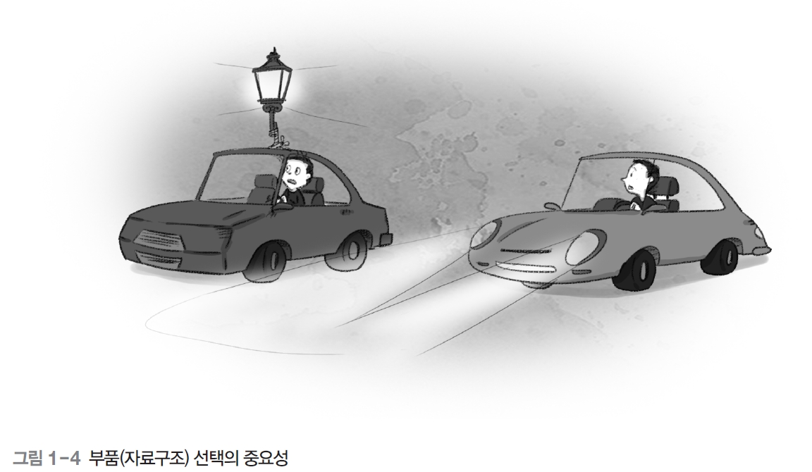
Role of DS
Data structure = Component to solve problems
Purpose of this module
Let you know various data structures
Let you can select a proper data structure for a given problem
Notes:
Data structures are like components of programs.
In this module, you learn which component is the most proper and how to use them most effectively for a given problem.
For example, what would you need if you had to drive a car down the street at night?
You'll need a light bulb and a car that can shine brightly.
If you don't know the existence of a part called a headlight, or how to use it in combination with a car, you will have an inefficient situation like the car on the left.
Therefore, in this data structure class, I will introduce these headlight-like components and show you how they can be used in programs.
자료구조는 우리가 사용하는 프로그램을 구성하는 부품같은 역할을 한다.
본 모듈에서는 문제가 주어질 때 어떤 부품을 어떻게 사용하는지는 가장 효율적인지를 학습합니다.
예를 들어 밤에 자동차를 몰고 길을 가야 한다고 하면 뭐가 필요할까요?
밝게 비칠 수 있는 전구와 자동차가 필요하겠죠.
만일 헤드라이트라는 부품의 존재를 모르거나 알더라도 어떻게 자동차와 조합해서 사용하는지를 모른다면 왼쪽 자동차와 같이 비효율적인 상황이 발생할 겁니다.
그러므로 본 자료구조 수업에서는 이런 헤드라이트같은 components를 알려주고 이것이 프로그램 내에서 어떻게 사용될 수 있는지 보입니다.

Slide 6
Related Subjects
Algorithm
Data Structures
Programming with Java
Discrete Mathmatics
Notes:
Learning data structures can be said to be training how to think like a programmer rather than simply learning about the components of a program.
In other words, the data structure itself is important, but it is equally important to train how to think.
In the process of solving problems using data structures, mathematical thinking is also very helpful, and the more systematic the thinking, the easier it is to create a way to design the logic in the process of solving the problem.
For this reason, the data structure class prerequisite knowledge and programming skills and discrete mathematics such as sequences, mathematical induction, and logic. I'm sure you already know this part. And, based on the data structure we learned this time, you will learn algorithms when you are a senior.
This data structure is included in the Engineer Information Processing and technical civil service exams in Korea, and it is an important subject that is frequently asked in the job interview in the computer field, and it is the basis of all computer science subjects.
자료구조를 배운다는 것은 단순히 프로그램의 components에 대해 배운다기 보다는 생각하는 방법을 훈련한다고 할 수도 있습니다.
즉, 자료구조는 그 자체도 중요하지만 그에 못지 않게, 생각하는 방법 훈련도 중요하다
자료구조를 이용해서 문제를 해결하는 과정에서 수학적 사고도 크게 도움이 되고, 사고가 체계적일 수록 문제 해결 과정에서 논리의 골격이 구성되는 방법을 만들기도 쉬어집니다.
그렇기 때문에 자료구조는 수열이나 수학적 귀납법, 논리학 등과 같은 이산 수학에 대한 지식과 프로그래밍 기술이 필요합니다. 저는 이미 여러분이 이 부분을 알고 계실거라고 생각합니다. 그리고, 이번에 배운 자료구조를 기반하여 algorithm을 공부할 필요가 있습니다.
이 자료구조는 우리나라의 정보처리 기사나 공무원 기술직 시험에도 포함되고, 전산직에서도 자주 출제되는 중요한 과목이며 모든 전산 과목의 기초가 됩니다.

Slide 7
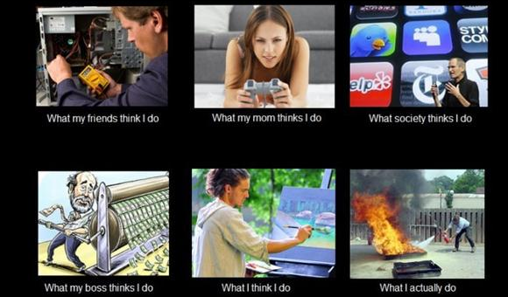
Programmer?

Slide 8
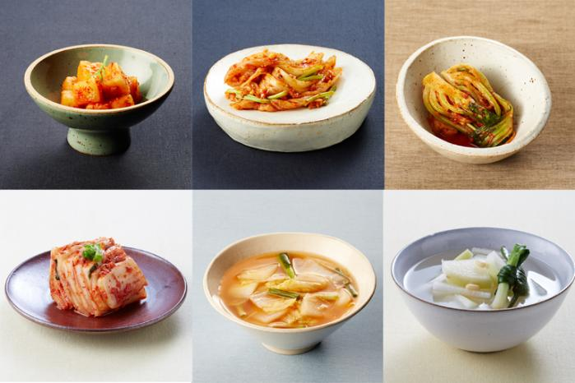

Programmer’s Thinking
Knowledge
Declarative knowledge
Kimchi
$y=\sqrt{x}$ if $x=y^{2}$
Imperative knowledge
Recipe of Kimchi
How to calculate $y=\sqrt{x}$
Notes:
Declarative
Declarative knowledge is composed of statements of fact.
Example
A good health care plan improves the quality of medical care while saving money.
y=√x if x=y^2
Imperative knowledge is about how to accomplish something.

Slide 9
What you learn
Data structures
Advanced Java
Review of the concept of OO
Generics
Linear data structures
Index data structures
Nonlinear data structures
List
Stack
Queue
Binary tree
Hash table
Tree
Heap
Graph
Thinking Tech.
Recursion
Sorting

Slide 10
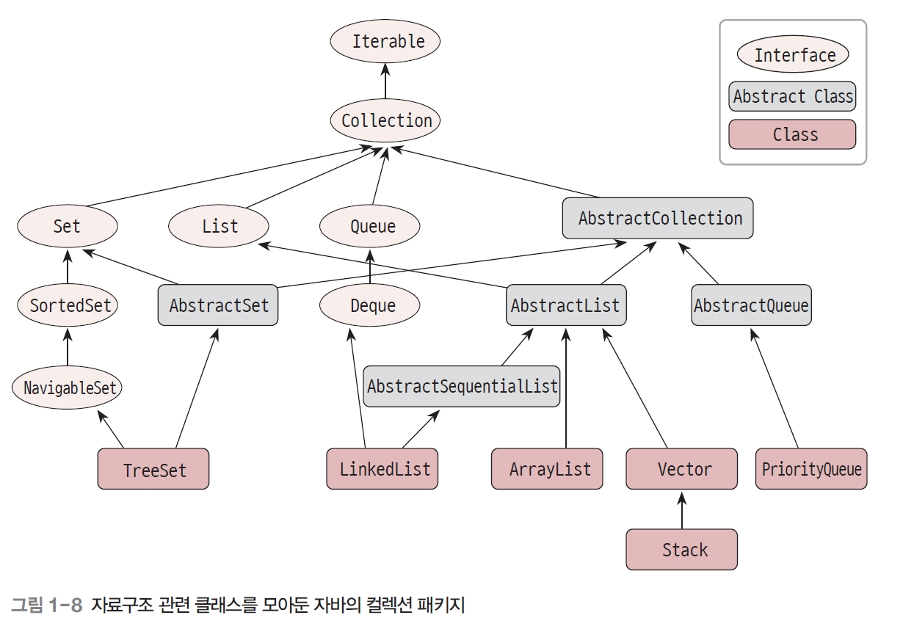
What you learn
Collections for data structures in Java package

Slide 11
Algorithm
a procedure for solving a mathematical problem in a finite number of steps that frequently involves repetition of an operation
Data structures are components building an algorithm
Representation
natural languages
Pseudocode
Flowcharts
pictorial representation of a program's logic.
programming languages
control tables (processed by interpreters)

Slide 12
Symbols
Usage | Symbol
Process
Decision Used to denote a decision point where alternate paths are possible
Start/End Used to indicate the beginning or ending of a flowchart
Loop
Input/Output
Link

Slide 13
Benefits
Portrays the logical "flow" between tasks
Visually successful in communicating the sequence of tasks
Easy to know the sequential impact of changes
Easy to spot redundant operations & other inefficiencies
Training tool for new employees
Spot internal control weaknesses
Helps the auditor see the “whole picture”

Slide 14
3 control flows
Sequential | Branching | Loop

Slide 15
Sequential
Sequential statements are executed in sequence, one after the other. (examples – print, input, assignment.)
Wake up
Wash up
dress
Go to school

Slide 16
Example
Write a flowchart that gets the length of a side as input and outputs the area of a square.
Start
Input S for the length of a side of a square
Calculate the area of a square using a formula
Output the area
Input S
A = S * S
Output A
End

Slide 17
Branching
Branching statements contain one or more choices and only one of the choices is executed
“if” statements can be categorized like:
where you want to do something or nothing.
Use the second format (if, else) for problems where you want to do one thing or another thing
Use the third format (if, else, if, else) for problems where you want to do one thing out of three or more choices.

Slide 18


Branching ^{0 or 1}
where you want to do something or nothing.
example:
Write an algorithm that prints "No school!" if temperature is below -10 ºC.
Java code
if (temperature < 10)
System.out.println(“No School!”);

Slide 19
Flowchart
Start
if (temperature < 10)
System.out.println(“No School!”);
Input temperature
temperature <10
yes
Output "No School"
End

Slide 20
Branching ^{2 choices}
where you want to do one thing or another thing.
example:
Write an algorithm that prints "warm" if temperature (a variable) is above 10 ºC and prints "cold" otherwise.
Java code
if (temperature > 10)
System.out.println(“warm”);
else System.out.println(“cold”);

Slide 21
Flowchart
if (temperature > 10)
System.out.println(“warm”);
else System.out.println(“cold”);
Start
Input temperature
temperature > 10
no
yes
Output “cold"
Output “warm"
End

Slide 22
Branching ^{multi choices}
where you want to do one thing out of three or more choices.
example:
Write an algorithm that prints "too cold" if temperature is below -10 ºC, "OK" if the temperature is between 10 and 30 ºC, and "too hot" if the temperature is above 30 ºC.
Java Code
if (temperature < -10)
System.out.println(“too cold”);
else if (temperature > 30) System.out.println(“too hot”);
Else System.out.println(“OK”);

Slide 23
Flowchart
if (temperature < -10)
System.out.println(“too cold”);
else if (temperature > 30) System.out.println(“too hot”);
Else System.out.println(“OK”);
Start
Input temperature
no
temperature < -10
temperature > 30
yes
yes
no
Output “too cold"
Output “too hot"
Output “OK"
no
End

Slide 24
Branching ^{multi choices}
example:
Write an algorithm that prints "31 days” if input M is one of 1, 3, 5, 7, 8, 10, 12 , "28 days" if M is 2, and otherwise “30 days”.
Start
Input M
M
2
1, 3, 5, 7, 8, 10, 12
4, 6, 9, 11
Output “31 days"
Output “30 days"
Output “28 days"
End

Slide 25
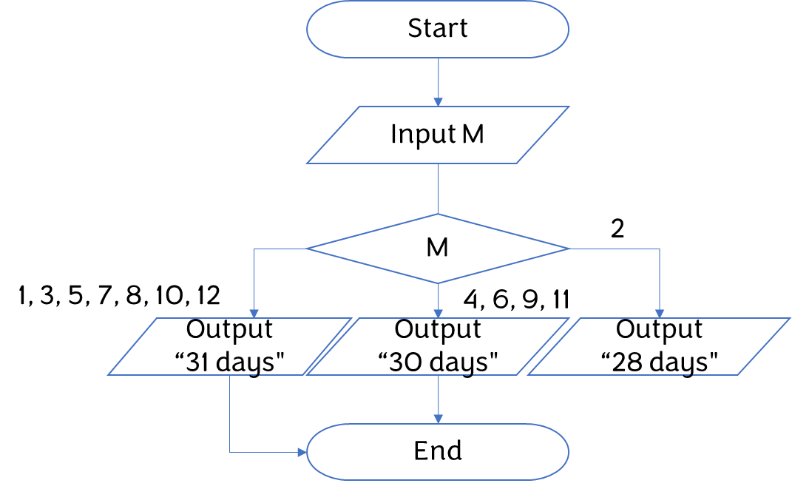
Branching ^{multi choices}
switch(M) {
case 4:
case 6:
case 9:
case 11:
System.out.println(“30 days“);
break;
case 2:
System.out.println(“28 days“);
break;
default:
System.out.println(“31 days“);
}
Notes:
1부터 12까지의 범위가 아닐때에 대한 값은?

Slide 26
Loop
Loop statements cause you to jump back to a previously executed statement. By continuing at that previous statement, a loop is formed.
print “Hello!” 10 times
START
count=1
START
F
count=1,10,1
count≤10
T
Print “Hello!”
Print “Hello!”
count=count+1
END
END

Slide 27
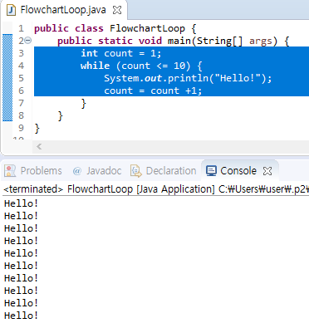
Java Code
START
count=1
F
count≤10
T
Print “Hello!”
count=count+1
END

Slide 28
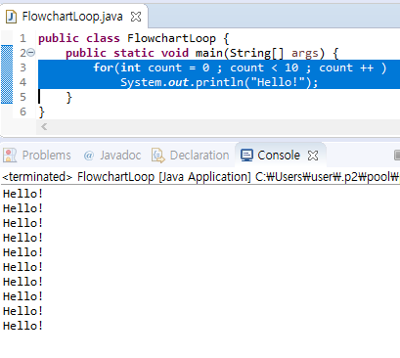
Java Code
START
count=1,10,1
Print “Hello!”
END

Slide 29
Summary

Slide 30
Summary
Data Structures: components of algorithms for solving problems
Algorithm: a procedure for solving a mathematical problem in a finite number of steps that frequently involves repetition of an operation
Flowchart
Sequence
Branching
Loop

Slide 31
Next week
Review of an Object-oriented concept
ADT
Class
Abstract class
Interface
Generics
Parameter class having some undecided types

Slide 32
Thank you!
Questions?
Exit

